Slide 1

Simple Linear Regression
Dr. Abolfazl Saghafi
Assistant Professor of Statistics
Data Science Program Director
Notes:
This week we learn about fitting a regression line. This is a VERY important subject in predictive modeling. You should focus on doing the computations both using Excel or calculator and R/Python. Now, lets get started…

Slide 2
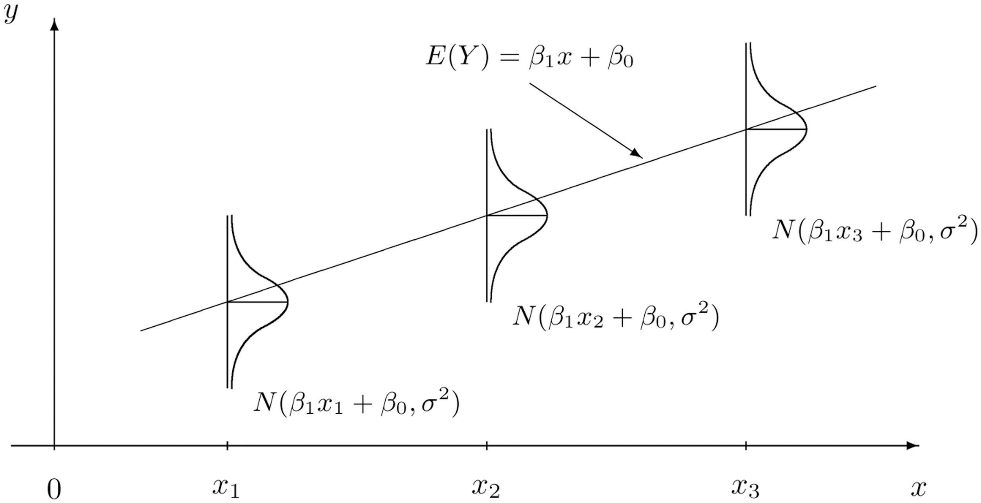
Summary
● Response/Predictor Variable
● Linear Regression
● Least Squares Estimation
● Normal Equations
Notes:
After a short introduction we start with Simple Linear Regression (SLR) and Normal Equations

Slide 3

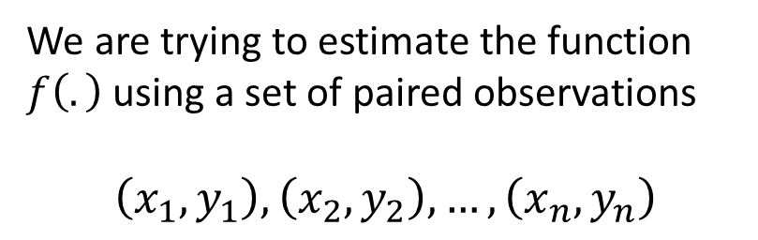


Response/Predictor Variable
Predictor variable
$$X$$
The Response variable is the outcome of a study. A variable you would be interested in predicting or estimating. Also called a dependent variable.
$$Y=f\left(X\right)+ε$$
Response variable
A Predictor variable is any variable that explains the response variable. Often called an independent variable or explanatory variable.
$$Y$$
We are trying to estimate the function $f\left(.\right)$ using a set of paired observations
$$\left(x_{1},y_{1}\right),\left(x_{2},y_{2}\right),…,\left(x_{n},y_{n}\right)$$
In general, we are interested in finding out how changes in the predictor variables affect the values of the response variables.
Notes:
We can distinguish two main types of variables, typically called predictor and response variables. The Response variable is the outcome of a study, generally shown by Y. It is a variable you’d be interested in predicting or estimating. It is also called a dependent variable. A Predictor variable is any variable that explains the response variable. Often called an independent variable or explanatory variable and is generally shown by X.
In general, we are interested in figuring out how changes in the predictor variables affect the values of the response variable. So, we assume that response variable is a function of predictor variable plus some additive errors. And the goal is to estimate this function $f\left(.\right)$ using a set of paired observations.
Throughout this course, we assume that the response variable is subject to random variation, the predictor variable is not, it is controlled.

Slide 4

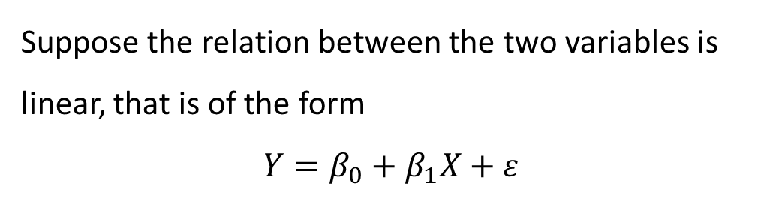

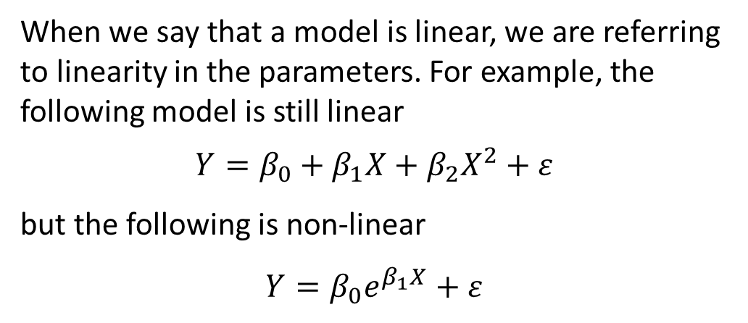






Linear Regression
Notation:
● $β_{0}$ is the intercept
● $β_{1}$ is the slope
● $ε$ is the random error
Suppose the relation between the two variables is linear, that is of the form
$$Y=β_{0}+β_{1}X+ε$$
$$Y$$
$$Y=β_{0}+β_{1}X+ε$$
When we say that a model is linear, we are referring to linearity in the parameters. For example, the following model is still linear
$$Y=β_{0}+β_{1}X+β_{2}X^{2}+ε$$
but the following is non-linear
$$Y=β_{0}e^{β_{1}X}+ε$$
$$∆Y$$
$$∆X$$
$β_{1}=\frac{∆Y}{∆X}$
$β_{0}$
$$X$$
Notes:
Suppose the relation between Y and X is linear, that is of the form $Y=β_{0}+β_{1}X+ε$. This is the equation of a line where $β_{0}$ is the intercept, that is the value of y when x is equal to zero. $β_{1}$ is the slope, that is the amount of change in Y given the change in X. Epsilon is the random error which usually is assumed to be additive.
The trick here is that, the linearity is considered based on the parameters $β_{0}$ and $β_{1}$ not the variables X and Y. For example, this second model is still linear because it is a linear function of the three parameters $β_{0}$, $β_{1}$ and $β_{3}$. But the third model is non-linear, it is actually exponential with additive error.
We first focus on the first model which is called a simple linear regression model.

Slide 5
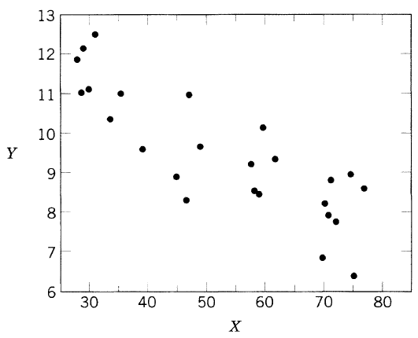
Example
Observation | X | Y
1 | 35.3 | 10.98
2 | 29.7 | 11.13
3 | 30.8 | 12.51
. . . | . . . | …
24 | 33.4 | 10.36
25 | 28.6 | 11.08
Consider the 25 observations of variable Y (pressure in pounds) and variable X (average atmospheric temperature in F), available on Bb.
(35.3, 10.98)
10.98
Scatter Plot in which the predictor variable is mapped on the horizontal and the response variable is mapped on the vertical axis. Each point represents an observation.
35.3
Notes:
As an example, consider the steam dataset that represents Pressure and Temperature in a saturated steam driven experimental device. We have 25 observations of variable Y which is pressure in pounds, and variable X which is average atmospheric temperature in Fahrenheit. Data is available on Bb. You can see some of the observations in the provided table.
The first step in regression modeling is to graph a scatterplot of the variables. It is a simple plot where pairs of (x, y) are plotted on the xy-plane. The response variable is always set on the y-axis and the predictor on the x-axis. You can see for example, that red dot represent the first observation, graphed at x equals 35.3 and y equals 10.98.
Looking at the scatterplot, we study the overall pattern of the plotted points. If there is a pattern, we should note its direction and strength. We should report whether there are any outliers, which are observations outside the overall pattern of data. In this plot, the relationship between the two variable seems to be linear. As x increases, y decreases. There is no outlier since all the points are within a fair distance from each other.

Slide 6

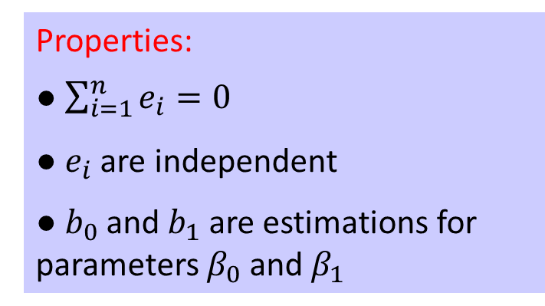






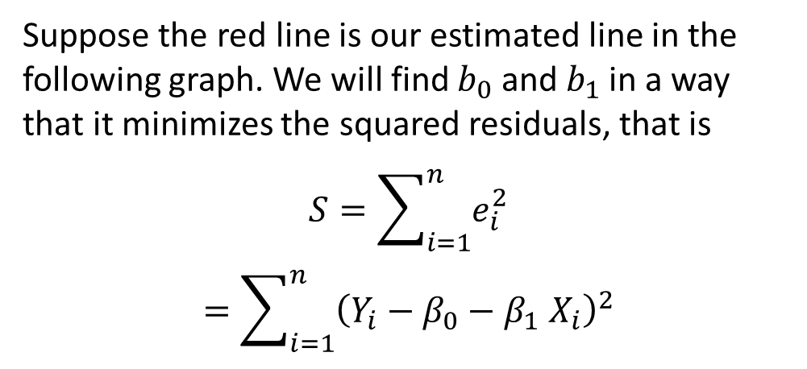
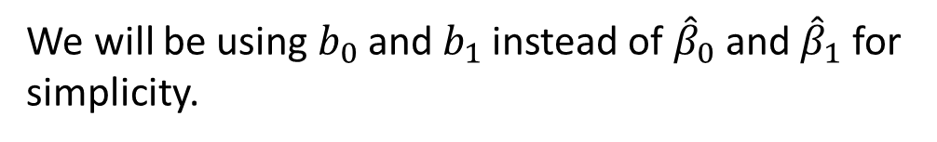



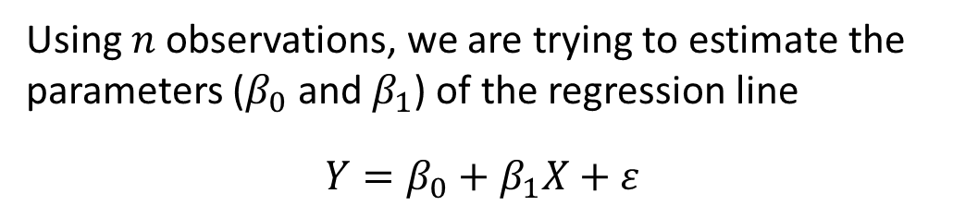
Least Squares Estimation
Properties:
● $\sum_{i=1}^{n}{e_{i}=0}$
● $e_{i}$ are independent
● $b_{0}$ and $b_{1}$ are estimations for parameters $β_{0}$ and $β_{1}$
Using $n$ observations, we are trying to estimate the parameters ($β_{0}$ and $β_{1}$) of the regression line
$$Y=β_{0}+β_{1}X+ε$$
Suppose the red line is our estimated line in the following graph. We will find $b_{0}$ and $b_{1}$ in a way that it minimizes the squared residuals, that is
$$S=\sum_{i=1}^{n}{e_{i}^{2}}$$
$$=\sum_{i=1}^{n}{{\left(Y_{i}−β_{0}−β_{1} X_{i}\right)}^{2}}$$
$$Y$$
$$Y_{i}=b_{0}+b_{1}X_{i}+e_{i}$$
$$e_{1}$$
$$e_{2}$$
$$e_{3}$$
$$e_{4}$$
$$e_{6}$$
$$Y=b_{0}+b_{1}X$$
$$e_{5}$$
We will be using $b_{0}$ and $b_{1}$ instead of ${\hat{β}}_{0}$ and ${\hat{β}}_{1}$ for simplicity.
$$X$$
Notes:
Lets try to estimate the parameters of the given regression line using the available six observations. The scatterplot shows the sample data. Suppose the red line is our estimated line in the given graph. Take a moment to realize what happened here. I am using $b_{0}$ and $b_{1}$ as estimates of $β_{0}$ and $β_{1}$. Referring to week one material, we will be using $b_{0}$ and $b_{1}$ instead of ${\hat{β}}_{0}$ and ${\hat{β}}_{1}$ for simplicity.
The second point is that, I changed the errors shown by Epsilon in the model to e in the estimate. This is because residual are estimates of error as well. We don’t have access to population data and cannot actually evaluate errors. Thus we estimate them as the deviation from the regression line.
Going back to the problem, we want to find $b_{0}$ and $b_{1}$ in a way that it minimizes the sum of squared residuals. Why not sum of residuals? Because summation of residuals is always equal to zero, due to the fact that positive and negative deviations cancel out each other. With a simple substitution, we arrive at this equation which has to be minimized with respect to $b_{0}$ and $b_{1}$.

Slide 7
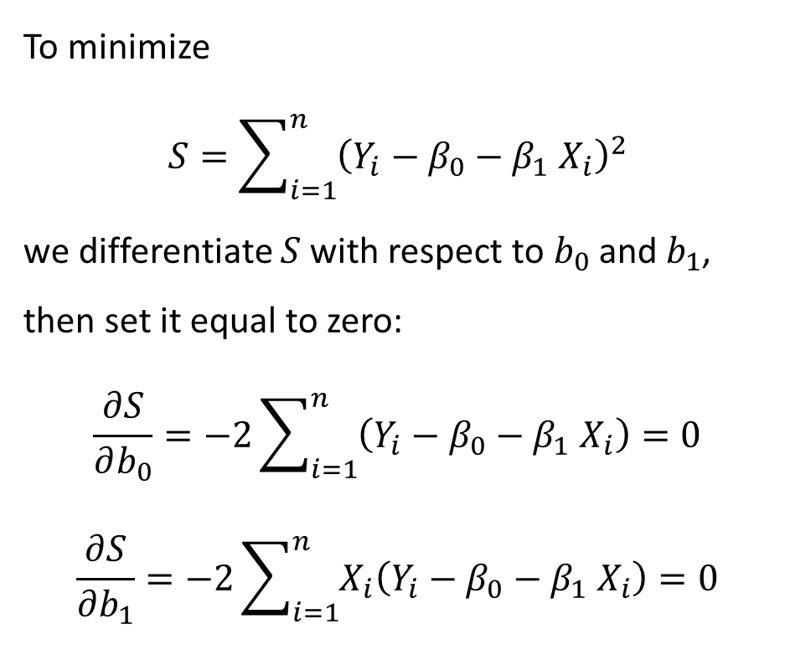



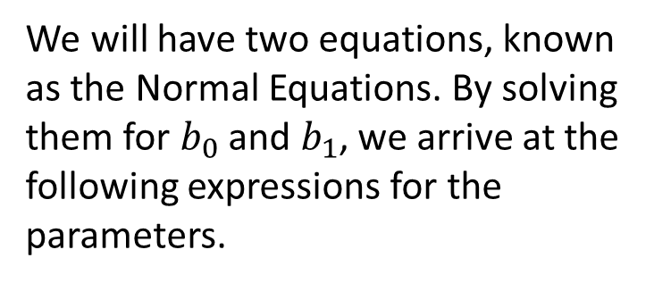
Normal Equations
We will have two equations, known as the Normal Equations. By solving them for $b_{0}$ and $b_{1}$, we arrive at the following expressions for the parameters.
To minimize
$$S=\sum_{i=1}^{n}{{\left(Y_{i}−β_{0}−β_{1} X_{i}\right)}^{2}}$$
we differentiate $S$ with respect to $b_{0}$ and $b_{1}$, then set it equal to zero:
$$\frac{∂S}{∂b_{0}}=−2\sum_{i=1}^{n}{\left(Y_{i}−β_{0}−β_{1} X_{i}\right)}=0$$
$$\frac{∂S}{∂b_{1}}=−2\sum_{i=1}^{n}{X_{i}\left(Y_{i}−β_{0}−β_{1}{ X}_{i}\right)}=0$$
$$b_{1}=\frac{\sum_{i=1}^{n}{\left(X_{i}−\overline{X}\right)\left(Y_{i}−\overline{Y}\right)}}{\sum_{i=1}^{n}{{\left(X_{i}−\overline{X}\right)}^{2}}}$$
$$=\frac{\sum_{i=1}^{n}{X_{i}Y_{i}}−n\overline{X}\overline{Y}}{\sum_{i=1}^{n}{X_{i}^{2}}−n{\overline{X}}^{2}}$$
$$=\frac{S_{XY}}{S_{XX}}$$
$$b_{0}=\overline{Y}−b_{1}\overline{X}$$
These are know as the Least Square Estimations.
Notes:
This expression is a convex function of the parameters, thus has a global minimum. Therefore, we can use Lagrange method to do the trick. That is, we differentiate the expression given by $S$ with respect to $b_{0}$ and $b_{1}$, then set it equal to zero. By doing so, we will have two equations, known as THE normal equations. By solving the normal equations for $b_{0}$ and $b_{1}$, we arrive at the given expressions for the parameters. These are know as the Least Square Estimations.

Slide 8
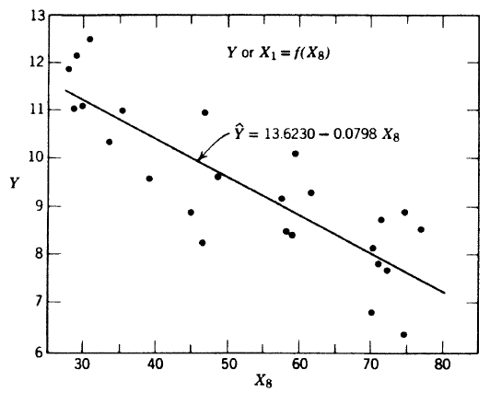
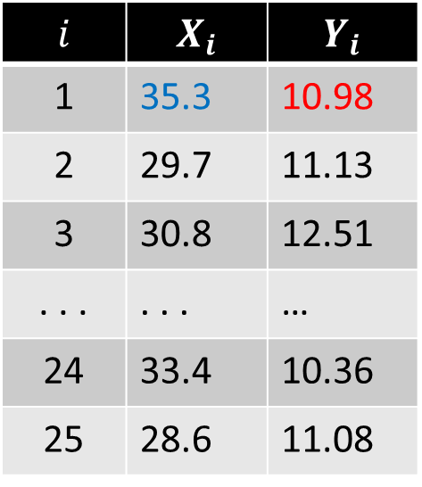
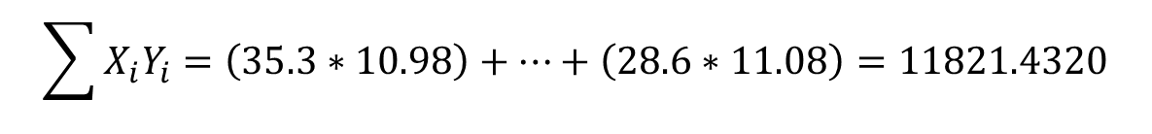
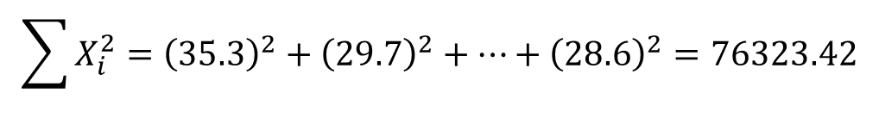
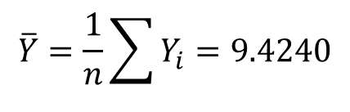
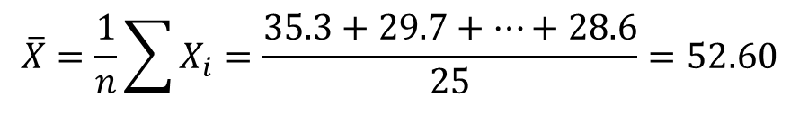
Example
$$i$$ | $$X_{i}$$ | $$Y_{i}$$
1 | 35.3 | 10.98
2 | 29.7 | 11.13
3 | 30.8 | 12.51
. . . | . . . | …
24 | 33.4 | 10.36
25 | 28.6 | 11.08
$$\overline{X}=\frac{1}{n}\sum{X_{i}}=\frac{35.3+29.7+…+28.6}{25}=52.60$$
$$\overline{Y}=\frac{1}{n}\sum{Y_{i}}=9.4240$$
$$\sum{X_{i}^{2}}={\left(35.3\right)}^{2}+{\left(29.7\right)}^{2}+…+{\left(28.6\right)}^{2}=76323.42$$
$$\sum{X_{i}Y_{i}}=\left(35.3∗10.98\right)+…+\left(28.6∗11.08\right)=11821.4320$$
$$b_{1}=\frac{\sum_{i=1}^{n}{X_{i}Y_{i}}−n\overline{X}\overline{Y}}{\sum_{i=1}^{n}{X_{i}^{2}}−n{\overline{X}}^{2}}=\frac{11821.4320−\left(25∗52.6∗9.424\right)}{76323.42−\left(25∗52.6∗52.6\right)}=−0.0798$$
$$b_{0}=\overline{Y}−b_{1}\overline{X}=9.424−\left(−0.079829∗52.6\right)=13.623$$
Notes:
It is not required of you to do the computations by hand, these calculations are done in statistical softwares to get you the answers. Knowing to perform the computations by Excel however helps with troubleshooting in more complex models.
Switch to R and do the computation in R, compare the results, codes are provided on handouts

Slide 9
Analysis of Variance
Dr. Abolfazl Saghafi
Assistant Professor of Statistics
Data Science Program Director
Notes:
Here we introduce Analysis of Variance which is used to test the significance of regressors.

Slide 10
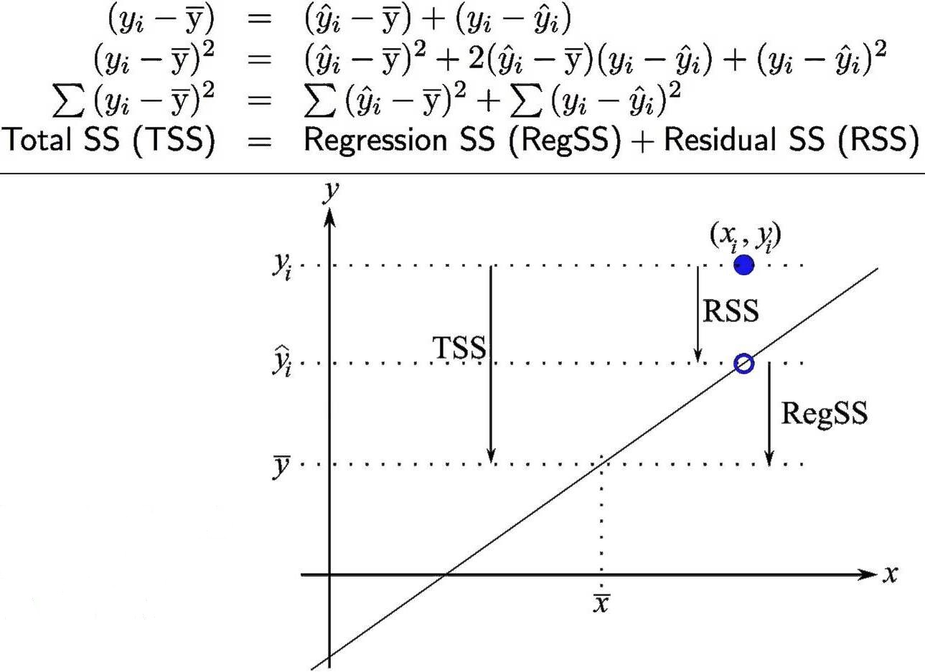
Summary
● Predictions and Residuals
● Analysis of Variance
● Degree of Freedom
● Coefficient of Determination
● Root MSE
Notes:
The subjects to be covered are mentioned here. Once you finished the slides, come back here and take a closer look at this photo which explains the who Analysis of Variance.

Slide 11

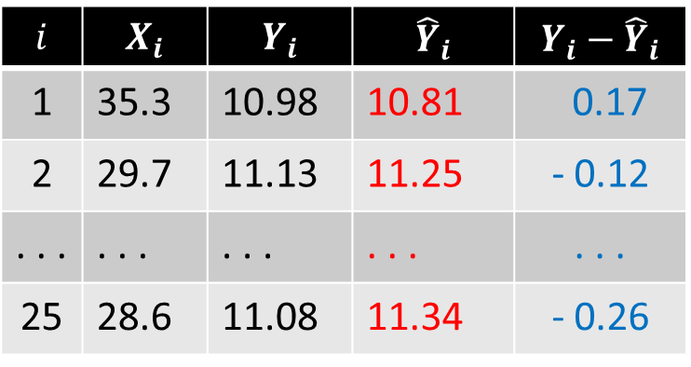
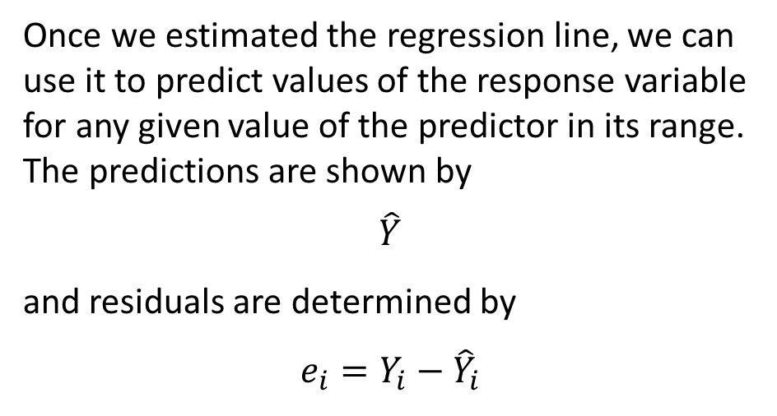
Predictions and Residuals
Once we estimated the regression line, we can use it to predict values of the response variable for any given value of the predictor in its range. The predictions are shown by
$\hat{Y}$
and residuals are determined by
$$e_{i}=Y_{i}−{\hat{Y}}_{i}$$
$$i$$ | $$X_{i}$$ | $$Y_{i}$$ | $${\hat{Y}}_{i}$$ | $$Y_{i}−{\hat{Y}}_{i}$$
1 | 35.3 | 10.98 | 10.81 | 0.17
2 | 29.7 | 11.13 | 11.25 | - 0.12
. . . | . . . | . . . | . . . | . . .
25 | 28.6 | 11.08 | 11.34 | - 0.26
$${\hat{Y}}_{i}=13.623−0.0798{ X}_{i}$$
$${\hat{Y}}_{1}=13.623−0.0798∗35.3=10.81$$
Notes:
Once we estimated the regression line, we can use it to predict values of the response variable for any given value of the predictor in its range. The predictions are shown by this notation, read as $\hat{Y}$. Hat notation stated earlier, is used to represent estimations. The residuals are then the difference between the observed response, and the estimated response on the regression line, that is $Y_{i}−{\hat{Y}}_{i}$ will be the residual for observation i.
For example, we estimated the regression line in the steam dataset as ${\hat{Y}}_{i}=13.623−0.0798{ X}_{i}$. The prediction for the first observation where the X equals 35.3 is then equals 10.81. Comparing this value with the actual observed Y, 10.98, gives us a residual as 0.17. Just like that, we can compute predictions at other observations and find their residual.

Slide 12


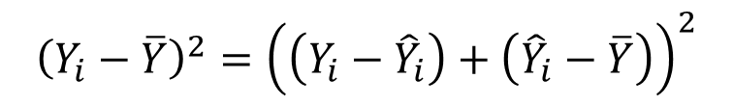
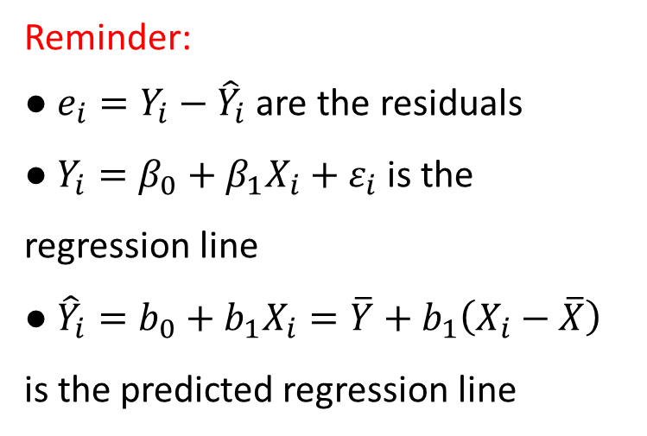

Analysis of Variance
Reminder:
● $e_{i}=Y_{i}−{\hat{Y}}_{i}$ are the residuals
● $Y_{i}=β_{0}+β_{1}X_{i}+ε_{i}$is the regression line
● ${\hat{Y}}_{i}=b_{0}+b_{1}X_{i}=\overline{Y}+b_{1}\left(X_{i}−\overline{X}\right)$ is the predicted regression line
Once we have the estimated regression line, we can determine how good the fit is. Starting with the following decomposition of variation
$$\left(\begin{aligned}Variation from \\ the mean\end{aligned}\right)=\left(\begin{aligned}Residuals \\ Effect\end{aligned}\right)+\left(\begin{aligned}Predictions \\ Effect\end{aligned}\right)$$
$$Y_{i}−\overline{Y}=\left(Y_{i}−{\hat{Y}}_{i}\right)+\left({\hat{Y}}_{i}−\overline{Y}\right)$$
$${\left(Y_{i}−\overline{Y}\right)}^{2}={\left(\left(Y_{i}−{\hat{Y}}_{i}\right)+\left({\hat{Y}}_{i}−\overline{Y}\right)\right)}^{2}$$
$$⇒$$
$$={\left(Y_{i}−{\hat{Y}}_{i}\right)}^{2}+{\left({\hat{Y}}_{i}−\overline{Y}\right)}^{2}+2\left(Y_{i}−{\hat{Y}}_{i}\right)\left({\hat{Y}}_{i}−\overline{Y}\right)$$
$$\sum_{i}{{\left(Y_{i}−\overline{Y}\right)}^{2}}=\sum_{i}{{\left(Y_{i}−{\hat{Y}}_{i}\right)}^{2}}+\sum_{i}{{\left({\hat{Y}}_{i}−\overline{Y}\right)}^{2}}+2\sum_{i}{\left(Y_{i}−{\hat{Y}}_{i}\right)\left({\hat{Y}}_{i}−\overline{Y}\right)}$$
$$⇒$$
Notes:
Once we estimated the regression line, we can determine how good the fit is using the following decomposition of variation. Variation of each observation from the overall mean is equal to variation of that observation from its estimation, plus, variation of its estimation from the overall mean. This is mathematically true since the two sides are equal.
Once we raise both sides to power 2, and sum it up over all the observations, we arrive at this statement. Summation of squared deviations of observations from mean equals summation of squared deviations of observations from the regression line, plus summation of squared deviations of estimations from the mean, plus a term which is equal to zero. If we replace and ${\hat{Y}}_{i}$ from its definition, you can easily verify that.

Slide 13

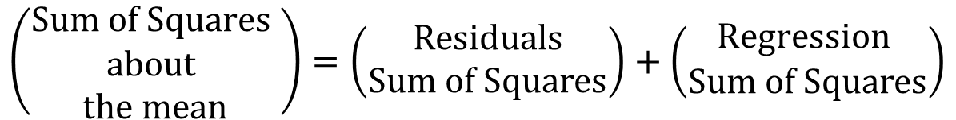
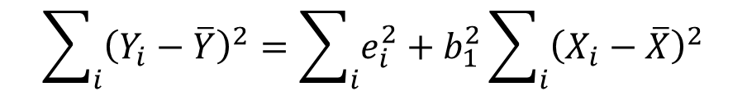
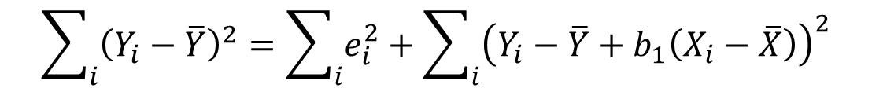

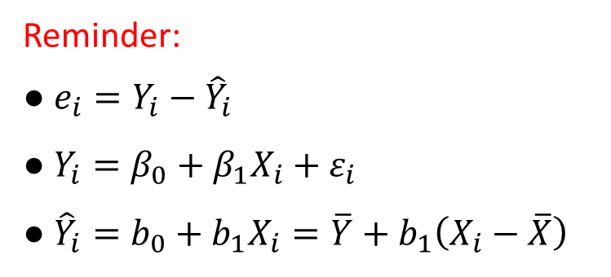

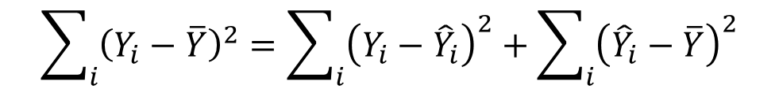
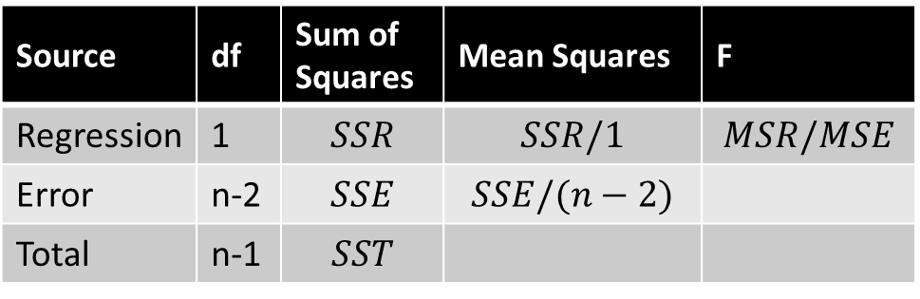
Analysis of Variance
Reminder:
● $e_{i}=Y_{i}−{\hat{Y}}_{i}$
● $Y_{i}=β_{0}+β_{1}X_{i}+ε_{i}$
● ${\hat{Y}}_{i}=b_{0}+b_{1}X_{i}=\overline{Y}+b_{1}\left(X_{i}−\overline{X}\right)$
$$\sum_{i}{{\left(Y_{i}−\overline{Y}\right)}^{2}}=\sum_{i}{{\left(Y_{i}−{\hat{Y}}_{i}\right)}^{2}}+\sum_{i}{{\left({\hat{Y}}_{i}−\overline{Y}\right)}^{2}}$$
$$\left(\begin{aligned}Sum of Squares \\ about \\ the mean\end{aligned}\right)=\left(\begin{aligned}Residuals \\ Sum of Squares\end{aligned}\right)+\left(\begin{aligned}Regression \\ Sum of Squares\end{aligned}\right)$$
$$\sum_{i}{{\left(Y_{i}−\overline{Y}\right)}^{2}}=\sum_{i}{e_{i}^{2}}+\sum_{i}{{\left(Y_{i}−\overline{Y}+b_{1}\left(X_{i}−\overline{X}\right)\right)}^{2}}$$
$$\sum_{i}{{\left(Y_{i}−\overline{Y}\right)}^{2}}=\sum_{i}{e_{i}^{2}}+b_{1}^{2}\sum_{i}{{\left(X_{i}−\overline{X}\right)}^{2}}$$
Source | df | Sum of Squares | Mean Squares | F
Regression | 1 | $$SSR$$ | $$SSR/1$$ | $$MSR/MSE$$
Error | n-2 | $$SSE$$ | $$SSE/(n−2)$$
Total | n-1 | $$SST$$
$$⇒$$
$$SST=SSE+SSR$$
$$⇒$$
Notes:
So, we arrive at this statement which breaks the Sum Squares about the mean to Residual Sum Square plus Regression Sum Square. Why is it called residual SS, because you can simplify that expression and what’s inside is going to be the residuals. The Second term also look to the regression line and can further be simplified as this expression. You can find details in the reference books.
This decomposition is shown by SSTotal for the first part, SSE for the second part, and SSR for the third part. The table that follows is known as the ANOVA table. We have the three Sum Squares, DF which represents degree of freedom. In simple linear regression, the DF for SST is always equal to sample size subtracted by one. That is the corrected SST. The Regression SS has one degree of freedom, that is the number of parameters in the model excluding the intercept, and SSE has n minus one DF. The Mean squares are each SS divided by their DF. The F statistic is computed by dividing the MSR by MSE

Slide 14
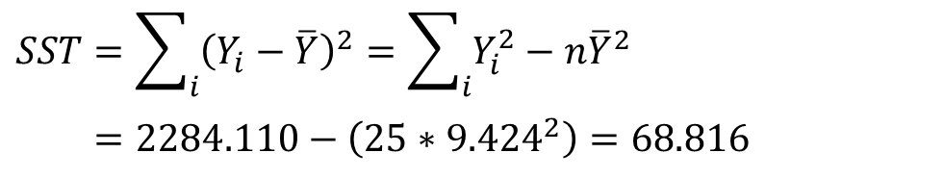


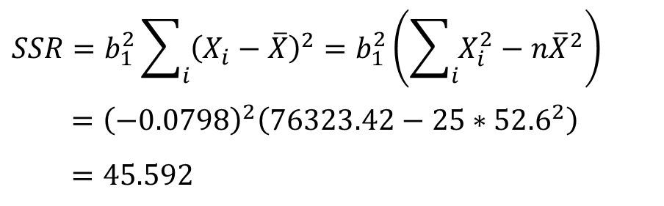
Example
$$\hat{Y}=13.623−0.0798 X$$
Consider example of regressing Pressure (Y) on average atmospheric temperature (X). We can compute
$$SST=\sum_{i}{{\left(Y_{i}−\overline{Y}\right)}^{2}}=\sum_{i}{Y_{i}^{2}}−n{\overline{Y}}^{2}$$
$$=2284.110−\left(25∗{9.424}^{2}\right)=68.816$$
$$SSR=b_{1}^{2}\sum_{i}{{\left(X_{i}−\overline{X}\right)}^{2}}=b_{1}^{2}\left(\sum_{i}{X_{i}^{2}}−n{\overline{X}}^{2}\right)$$
$$={\left(−0.0798\right)}^{2}\left(76323.42−25∗{52.6}^{2}\right)$$
$$=45.592$$
Source | df | Sum of Squares | Mean Squares | F
Regression | 1
Error
Total
$$SSE=SST−SSR$$
Notes:
Les see an example. Consider example of regressing Pressure (Y) on average atmospheric temperature (X). We can compute SS Total using this expression, which can be further simplified as this second expression. I suggest you use excel to do the computations, it helps you to get familiar with these formula and build up on your excel skills. SAS itself can generate these numbers easily.
Regression SS is computed by this expression, having the regression line, we know the value of b1, the rest requires some computations which you can use excel to verify. Now that we have the numbers, we can add them to the table. We don’t have to compute the SSE manually, we already know that it is the difference between SST and SSR. The rest of the table is easy to fill up.

Slide 15
More on ANOVA Table
Source | df | Sum of Squares | Mean Squares | F
Regression | 1 | $$SSR$$ | $$\frac{MSR}{1}$$ | $$\frac{MSR}{MSE}$$
Residual | n-2 | $$SSE$$ | $$\frac{SSE}{n−2}$$
Total | n-1 | $$SST$$
We already discussed that
$$Y_{i} \sim ^{iid} N(β_{0}+β_{1}X_{i},σ^{2})$$
We can show that
$$E(MSR)=σ^{2}+β_{1}^{2}\sum{{\left(X_{i}−\overline{X}\right)}^{2}}$$
$$E\left(MSE\right)=σ^{2}$$
Thus, $F$is used to test $H_{0}: β_{1}=0$
Values higher than a critical point shown by $F_{\left(α, 1,n−2\right)}$ rejects $H_{0}$ at significance level $α$.
It can be shown that under a null hypothesis of $β_{1}=0$
$$\frac{MSR}{σ^{2}} \sim χ_{\left(1\right)}^{2} ⊥ \frac{\left(n−2\right)MSE}{σ^{2}} \sim χ_{\left(n−2\right)}^{2}$$
Therefore
$$F=\frac{MSR}{MSE} \sim F_{\left(1,n−2\right)}$$
This is analogous to testing $H_{0}: β_{1}=0$ using $t$ distribution since
$${t^{2}=F}_{\left(1,n−2\right)}$$
Notes:
We already discussed the distribution of observations. With some computations, we can show that expected value of Regression Mean Square equals sigma square plus a positive term that depends on beta1. We can also show that expected value of Error Mean Square equals sigma square.
Therefore, under null hypothesis assumption, Regression Mean Square over sigma square has a chi-square distribution with one degree of freedom. On the other hand, (n-2) times Error Mean Square over sigma square has a chi-square distribution with (n-2) degree of freedom. These two distributions are independent. Therefore, Regression Mean Square over Error Mean Square follows a F distribution with 1 and n-2 degree of freedom. This is a very important result which enables an alternate way in testing whether beta1, the slope of the regression line, is statistically significant.
To do that, once we computed the F value, we compare it to F distribution critical value. Softwares do this automatically but you have be able to perform these computations yourself. To find F critical values, you may use excel, your calculator, F tables, o any online resources.
The final point is that, this F value is the exact value of the t squared where you computed in testing beta1. The p-values for the two tests will be the same as well.

Slide 16
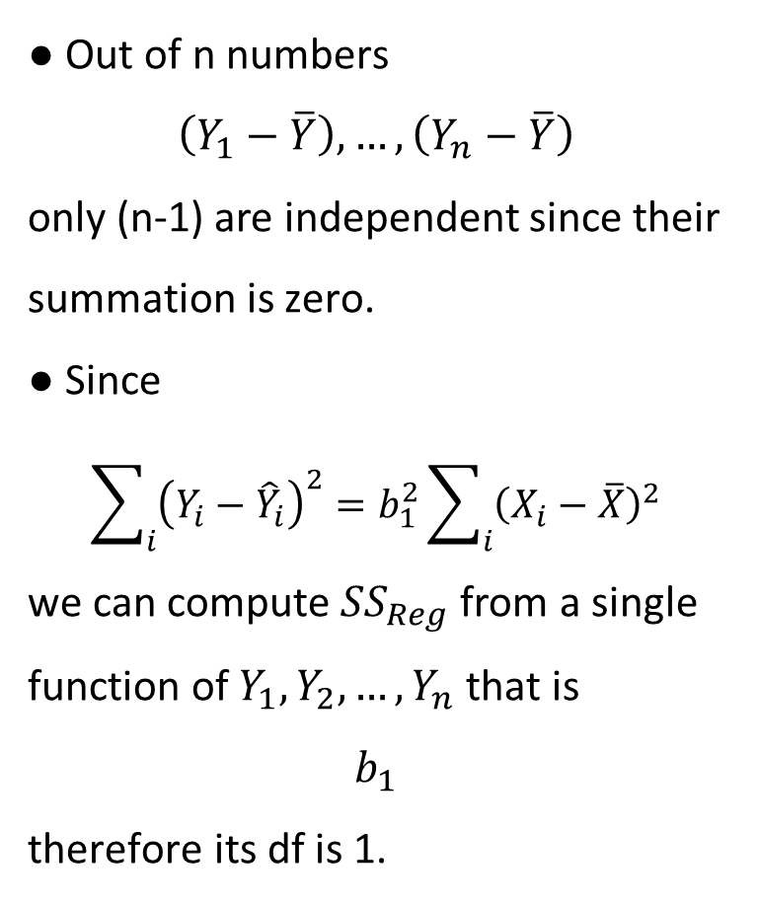
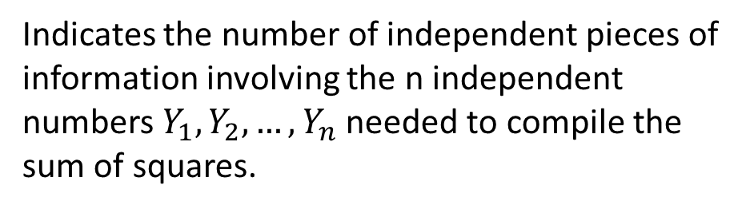

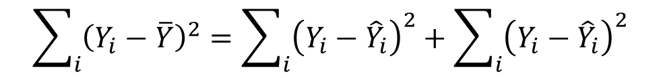

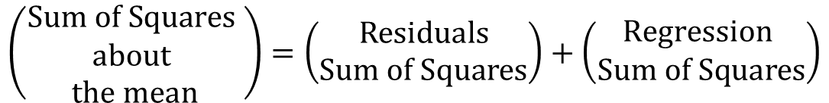
Degree of Freedom
● Out of n numbers
$$\left(Y_{1}−\overline{Y}\right),…,\left(Y_{n}−\overline{Y}\right)$$
only (n-1) are independent since their summation is zero.
● Since
$$\sum_{i}{{\left(Y_{i}−{\hat{Y}}_{i}\right)}^{2}}=b_{1}^{2}\sum_{i}{{\left(X_{i}−\overline{X}\right)}^{2}}$$
we can compute ${SS}_{Reg}$ from a single function of $Y_{1},Y_{2},…,Y_{n}$ that is
$$b_{1}$$
therefore its df is 1.
Indicates the number of independent pieces of information involving the n independent numbers $Y_{1}, Y_{2}, …, Y_{n}$ needed to compile the sum of squares.
$$\left(\begin{aligned}Sum of Squares \\ about \\ the mean\end{aligned}\right)=\left(\begin{aligned}Residuals \\ Sum of Squares\end{aligned}\right)+\left(\begin{aligned}Regression \\ Sum of Squares\end{aligned}\right)$$
$$\sum_{i}{{\left(Y_{i}−\overline{Y}\right)}^{2}}=\sum_{i}{{\left(Y_{i}−{\hat{Y}}_{i}\right)}^{2}}+\sum_{i}{{\left(Y_{i}−{\hat{Y}}_{i}\right)}^{2}}$$
$$SST=SSE+SSR$$
$$\left(n−1\right)=(n−2)+1$$
Notes:
The degree of freedom in the ANOVA table indicates the number of independent pieces of information involving the n independent numbers $Y_{1}, Y_{2}, …, Y_{n}$ needed to compile the sum of squares. The total SS has degree of freedom of n-1, meaning that Out of n set of numbers $\left(Y_{1}−\overline{Y}\right),…,\left(Y_{n}−\overline{Y}\right)$, only (n-1) are independent, that’s because their summation is zero.
You might have guessed it already, assuming the normal distribution for errors, the observations will have a normal distribution, too. Therefore, their squared deviation from their mean will follow a chi-square distribution with n-1 df. The regression term itself follows a chi-square distribution with one degree of freedom. There is only one parameter present in that term and that is b1.
The error term is independent of the other two terms and has a chi-square distribution with n-2 df.

Slide 17
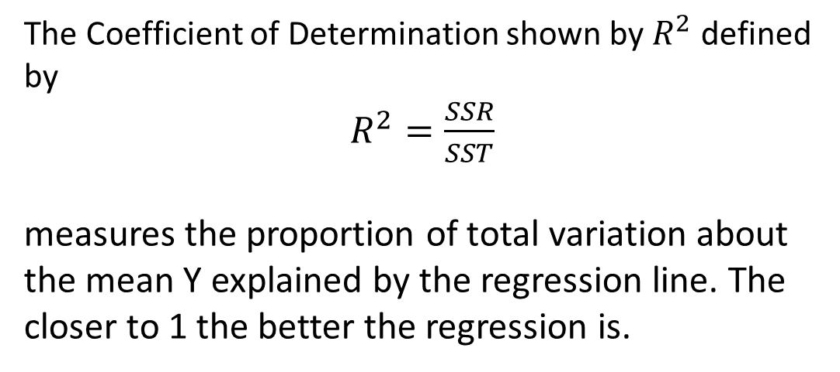
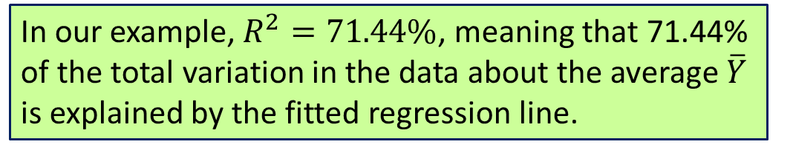
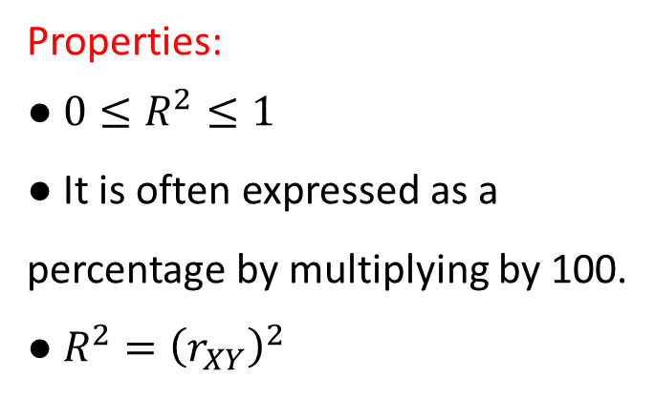
Coefficient of Determination
Properties:
● $0≤R^{2}≤1$
● It is often expressed as a percentage by multiplying by 100.
● $R^{2}={\left(r_{XY}\right)}^{2}$
The Coefficient of Determination shown by $R^{2}$ defined by
$R^{2}=\frac{SSR}{SST}$
measures the proportion of total variation about the mean Y explained by the regression line. The closer to 1 the better the regression is.
In our example, $R^{2}=71.44\%$, meaning that 71.44% of the total variation in the data about the average $\overline{Y}$ is explained by the fitted regression line.
Notes:
To measure how good a regression line is, we can use Coefficient of Determination. It is shown by $R^{2}$ and defined by dividing SSR by SST. It measures the proportion of total variation about the mean Y explained by the regression line. It is always between 0 and 1, the closer to 1 the better the regression line is. Usually we present that in terms of percent.
In our example, $R^{2}=71.44\%$, meaning that 71.44% of the total variation in the data about the average $\overline{Y}$ is explained by the fitted regression line.

Slide 18
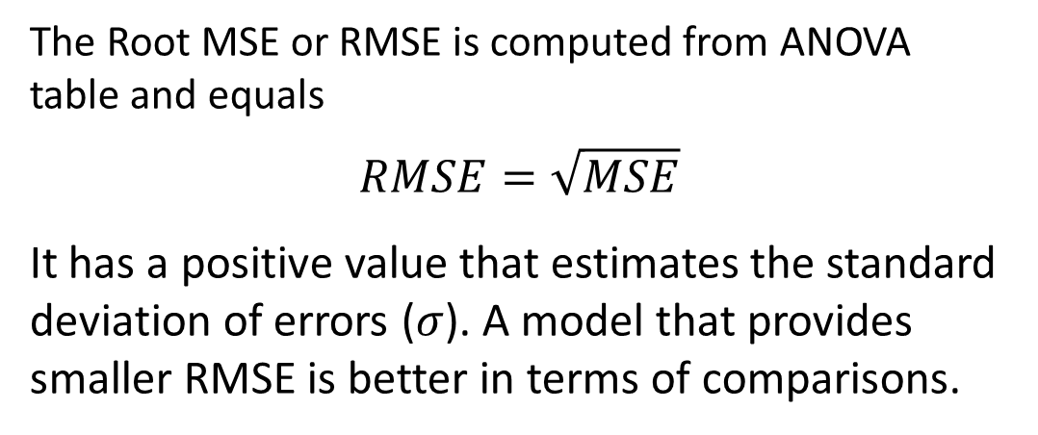
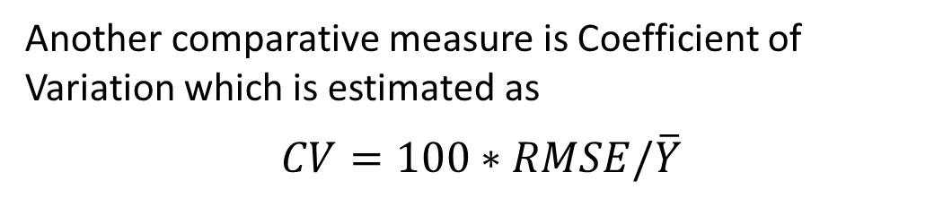
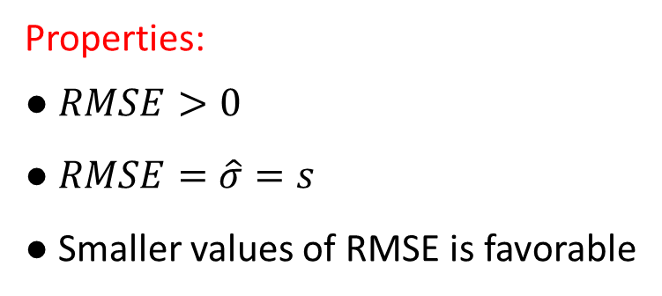
Root MSE
Properties:
● $RMSE>0$
● $RMSE=\hat{σ}=s$
● Smaller values of RMSE is favorable
The Root MSE or RMSE is computed from ANOVA table and equals
$$RMSE=\sqrt{MSE}$$
It has a positive value that estimates the standard deviation of errors ($σ$). A model that provides smaller RMSE is better in terms of comparisons.
● CV is unitless
● Smaller values of CV is favorable
● CV is a known measure of risk
In our steam example, $RMSE=0.89$
Another comparative measure is Coefficient of Variation which is estimated as
$$CV=100∗RMSE/\overline{Y}$$
Notes:
A second Goodness of Fit measure is Root MSE, or RMSE which is computed as the square root of MSE. It has a positive value that estimates the standard deviation of errors ($σ$). A model that provides smaller RMSE is better in terms of comparisons. In our steam example, $RMSE=0.89$.
Another comparative measure is Coefficient of Variation which is estimated as $CV=100∗RMSE/\overline{Y}$. This is a unitless measure, it’s smaller values are favorable when comparing alternative models, and is well-known in risk management especially in stock market and other securities.

Slide 19
Residual Analysis
Dr. Abolfazl Saghafi
Assistant Professor of Statistics
Data Science Program Director
Notes:
In this session we discuss regression preliminary assumptions and learn to check them.

Slide 20
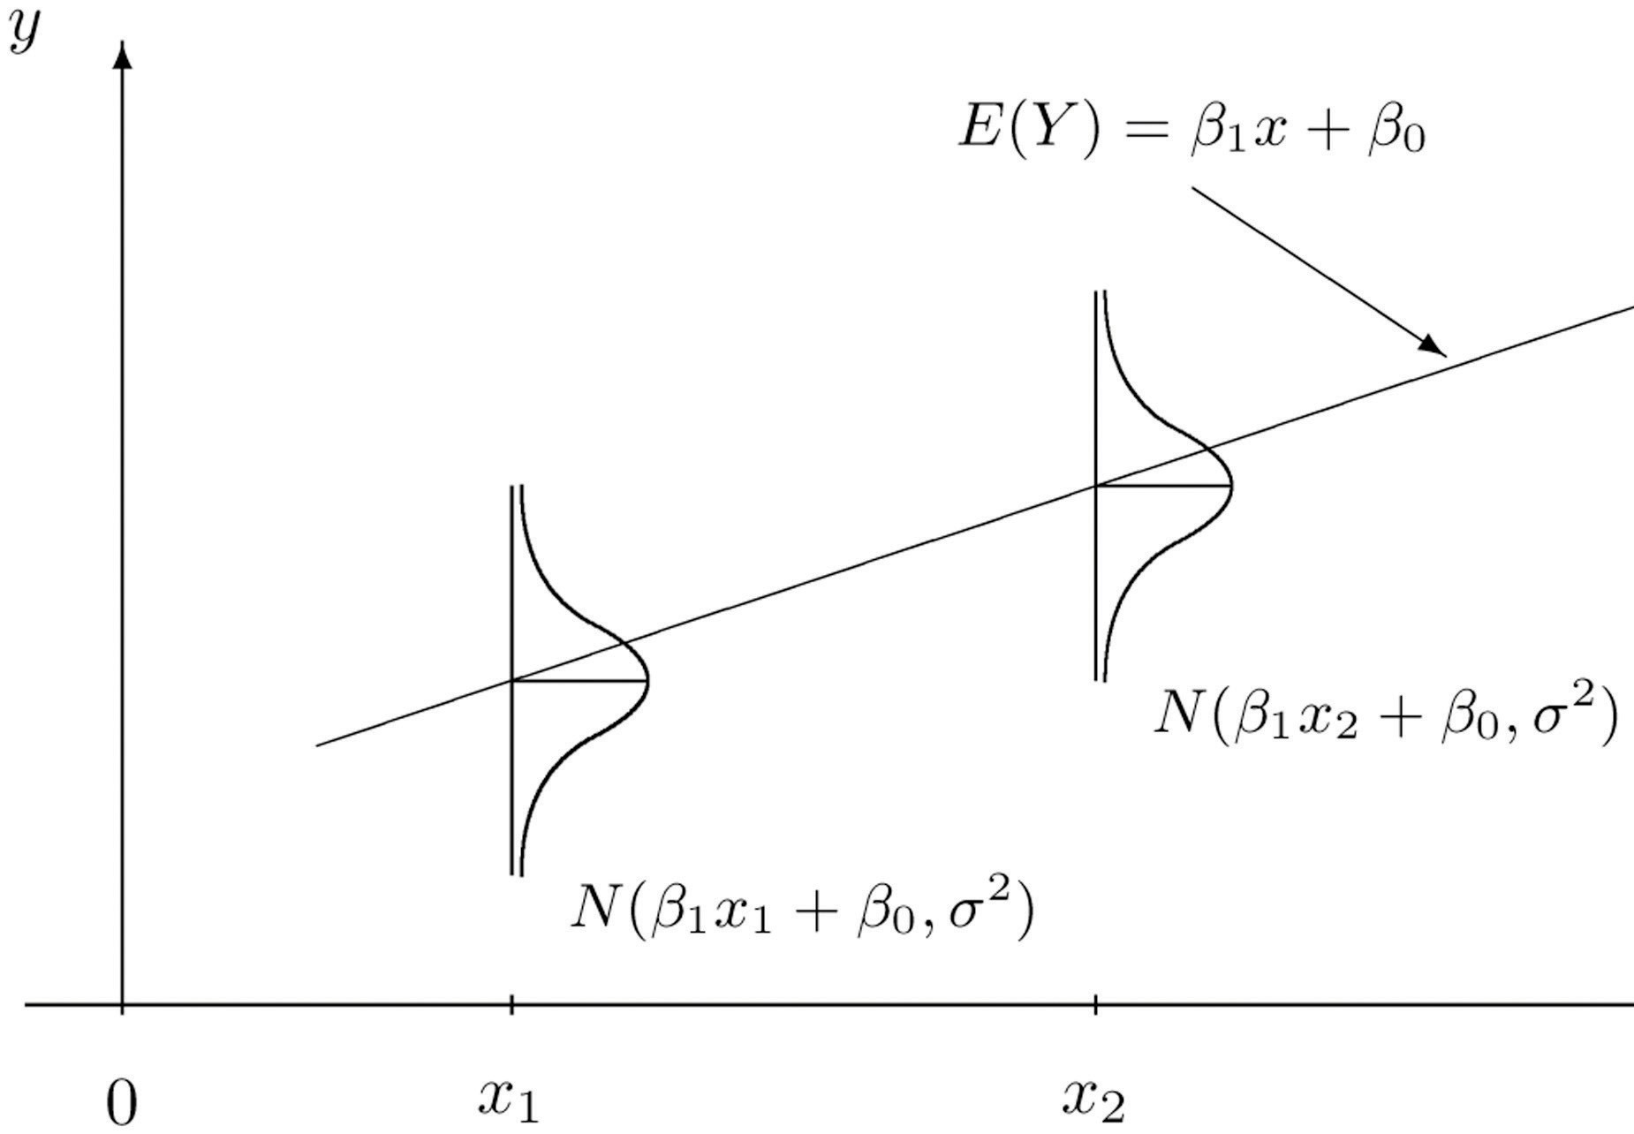
Summary
● Linear Relationship
● Independent Errors
● Constant Variance
● Normal Distribution of Errors
Notes:
In performing the regression analysis we make certain assumptions about the errors. Therefore, if our fitted model is correct, the residuals should exhibit tendencies that confirm these assumptions, at least, should not exhibit a violation of the assumptions. In this part, we review these assumptions and see various ways we can check them.

Slide 21
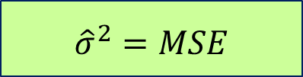
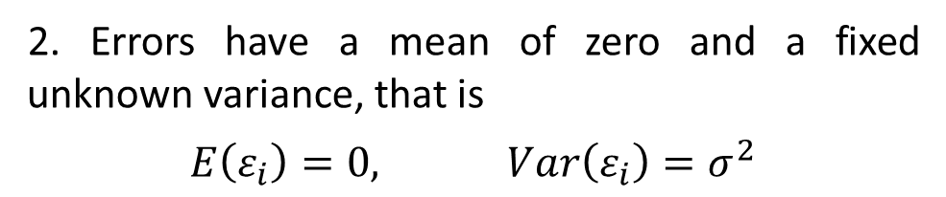
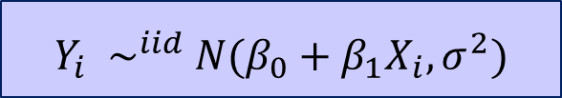
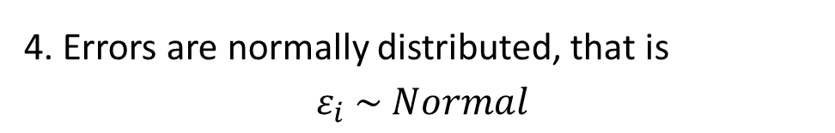
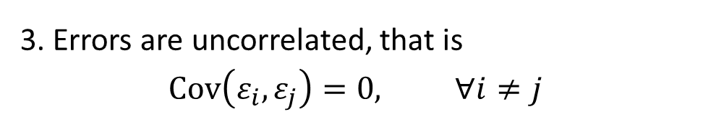
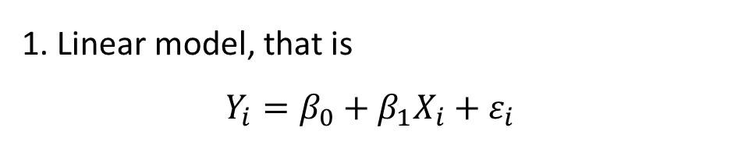
Model Assumptions
Notes:
● To have reliable point estimation for parameters and even predictions ONLY assumption 1 should be valid.
● Assumption 4 is used for the purpose of testing, and creating confidence intervals.
● There is a tendency for errors that occur in many real situations to be normally distributed due to the Central Limit Theorem.
1. Linear model, that is
$$Y_{i}=β_{0}+β_{1}X_{i}+ε_{i}$$
2. Errors have a mean of zero and a fixed unknown variance, that is
$$E\left(ε_{i}\right)=0, Var\left(ε_{i}\right)=σ^{2}$$
3. Errors are uncorrelated, that is
$$Cov\left(ε_{i},ε_{j}\right)=0, ∀i≠j$$
$$Y_{i} \sim ^{iid} N(β_{0}+β_{1}X_{i},σ^{2})$$
4. Errors are normally distributed, that is
$$ε_{i} \sim Normal$$
$${\hat{σ}}^{2}=MSE$$
ML Estimation
Notes:
Up to this point all we assumed was that there is linear relationship between X and Y. Then, a number of specified algebraic calculations have been made to make estimations and that is all. We now make some basic assumptions and use them to investigate the model deeper. Now assume that we have a linear model.
Number two. Errors have a mean of zero and a fixed unknown variance, that is Expected value of errors, that is the population error term, is equal to zero. Its variance is equal to a fixed number sigma square.
Number three. Errors are uncorrelated, that is Covariance or Correlation of two distinct error term is equal to zero.
Number four. Errors are normally distributed.
Assumption 3 and 4 together suggest that the errors are independent, because when the distribution is normal, uncorrelated means independent. The normality assumption is used for the purpose of testing which is reasonable for many real situations according to Central Limit Theorem.
Referring back to the model itself, the three assumption mean that for a given value of X, observations are independent and normally distributed with mean $β_{0}+β_{1}X$ and variance sigma square. Now you understand what the graph on the previous slide meant. A point estimation for error variance is the MSE in the ANOVA table. This is a maximum likelihood estimation, that it maximizes the likelihood of occurring such observations given the predictor variable.

Slide 22

Linear Relationship
Assumption
● $Y_{i}=β_{0}+β_{1}X_{i}+ε_{i}, i=1,…,n$
The initial scatterplot is the best diagnosis for checking the linearity assumption.
Effect of Violation
● Parameter estimates are biased
● Unreliable predictions
Diagnosis
● Initial scatterplot of $X_{i}$ vs $Y_{i}$
● Small $R^{2}$
● Pattern in scatterplot of $X_{i}$ vs $e_{i}$
Notes:
Initially we assumed a linear relationship between the variables. If this assumption is not valid, then parameter estimates are biased and predictions are unreliable.
We have a couple of ways to check this assumption. The initial scatterplot, that is the graph of the independent variable versus the dependent variable, is the best diagnosis for checking the linearity assumption. This graph should illustrate a linear relationship between the two variables. For example, the two graphs on the right show that an increase in X, leads to a linear increase in Y. The two graphs on the left, demonstrate a non-linear behavior.
Small $R^{2}$ is also a sign that a linear relationship is inadequate. Pattern in scatterplot of $X_{i}$ vs $e_{i}$ also revoke linearity assumption.

Slide 23


Residuals Vs Errors
● $ε_{i}$ are errors
● $e_{i}$ are residuals
● $Y_{i}$ are observations
● ${\hat{Y}}_{i}$ are fitted values
● $\hat{σ}=RMSE$
Residuals are estimations for errors in the model, that is
$$e_{i}={\hat{ε}}_{i}$$
where, they are defined as
$$e_{i}=Y_{i}−{\hat{Y}}_{i}$$
Important properties
● $\sum{e_{i}}=0$
● $\sum{x_{i}}e_{i}=\sum{{\hat{y}}_{i}}e_{i}=0$
● $Var\left(e_{i}\right)=σ^{2}\left(1−\frac{1}{n}−\frac{{\left(x_{i}−\overline{x}\right)}^{2}}{\sum_{i}{{\left(x_{i}−\overline{x}\right)}^{2}}}\right)$
Sometimes studentized residuals (internally) are used for the purpose of model diagnostics, that is
$$e_{i}^{∗}=\frac{e_{i}}{\hat{σ}\sqrt{1−\frac{1}{n}−\frac{{\left(x_{i}−\overline{x}\right)}^{2}}{\sum_{i}{{\left(x_{i}−\overline{x}\right)}^{2}}}}}$$
Notes:
Before going more into residual analysis I would like to emphasize on the difference between residuals and errors. Residuals are estimations for unseen errors in the model, that is $e_{i}={\hat{ε}}_{i}$. We defined residuals as the difference between what is actually observed, and what is predicted by the regression equation.
Later we come across the term studentized residuals that are used for the purpose of model diagnostics. These are shown by $e_{i}^{∗}$ and defined by residuals divided by their individual standard error. That is, the expression shown here.

Slide 24


Independent Errors
Assumption
● $Cov\left(e_{i},e_{j}\right)=0, ∀i≠j$
In Durbin-Watson test defined by
$$d=\sum_{i=2}^{n}{{\left(e_{i}−e_{i−1}\right)}^{2}}/\sum_{i=1}^{n}{e_{i}^{2}}$$
1. $0≤d≤4$ always
2. Values of $d$ around $2$ confirms uncorrelated residuals; close to $0$ or $4$ represents serial correlation in residuals.
Effect of Violation
● Parameter estimates are still unbiased
● Error estimation is unreliable
● Inference is unreliable
Diagnosis
● Pattern in residual plot
● Durbin-Watson test
Notes:
One of the model assumptions that we had was independence of errors. If the assumption is not met, then model parameter estimates are still unbiased BUT error estimation and inference are unreliable. Pattern in residual plot and Durbin-Watson test are used to check and verify the assumption of independent errors.
We have remarked earlier that the residuals, unlike the errors, are not independent. Does this affect the plots? Yes. Does it invalidate the plots? In most situations, No. Although correlations and constraints affect distributions of functions of the residuals, the "corresponding effects on the graphical procedures ... can usually be neglected.
Durbin-Watson test checks for a sequential dependence in which each error (and so residual) is correlated with those before and after it in the sequence. The test focuses specifically on the differences between successive residuals in the following way. The Durbin-Watson statistic shown by d, is denied by the given expression. d is always between 0 and 4, values around 2 confirms uncorrelated residuals; close to $0$ or $4$ represents serial correlation in residuals. The graphs which are used when the order of observations is important, show serial correlation.

Slide 25




Constant Variance
Assumption
● ${Var(ε}_{i})=σ^{2}, i=1,2,…,n$
Satisfactory plot should give the following overall impression:
Effect of Violation
● Parameter estimates are still unbiased
● Error estimation is unreliable
Examples of unsatisfactory residual behavior include:
Diagnosis
● The time order of the data, if known.
● Scatterplot of ${\hat{Y}}_{i}$ vs $e_{i}$
● Scatterplot of $X_{i}$ vs $e_{i}$
● Bartlet (or Levene or White) test
Notes:
Another assumption we made was that the errors have a constant variance. When this assumption is not met, model parameter estimates are still unbiased but error estimation is unreliable. We can check this assumption by investigating The time order of the data, if known, scatterplot of ${\hat{Y}}_{i}$ vs $e_{i}$, and scatterplot of $X_{i}$ vs $e_{i}$.
In all of these graphs, a satisfactory plot is one that shows a (more or less) horizontal band of points giving the impression of rectangle. There are many possible unsatisfactory plots. Some typical ones include these three patterns:
The first of these three (the funnel) displays the band of residuals widening to the right showing non-constant variance. The second is an upward trend and the third is curvature. (All of these defective plots can appear in other directions, of course, for example, a reversed funnel or a downward curve.) It is difficult to be absolutely specific about what to do if these defects are found. Later we learn how to deal with such situations.
The White test tests the null hypothesis that the variance of the residuals is homogenous. Therefore, if the p-value is very small, we would have to reject the hypothesis and accept the alternative hypothesis that the variance is not homogenous.

Slide 26



Normal Distribution of Errors
Assumption
● $ε_{i} \sim Normal$
Normal pattern:
Effect of Violation
● Inference is fairly robust to nonnormality
● Prediction intervals are unreliable
Not Normal:
Diagnosis
● Histogram of residuals
● Normal PP or QQ plot
● Normality tests such as Kolmogorov-Smirnov and Shapiro-Wilk
Notes:
The final assumption is normality of errors. Inference is fairly robust to nonnormality however prediction intervals are unreliable if this assumption is violated.
Often a simple histogram, or a stem and leaf plot, will be enough to check this assumption. Normal PP or QQ plots are also a good tool to check this assumption. A normal distribution creates a PP or QQ plot in which points are spread along a line with little variation. If the dots do deviates a lot from a line then normality is not met.
There are also statistical tests that check normality. Tests such as Kolmogorov-Smirnov and Shapiro-Wilk.

Slide 27


Steam Dataset / Residual Analysis
● Linearity is checked best via the initial scatter plot of X8 vs Y and plot of X8 vs Residuals. The first plot confirm a linear association between X8 and Y. The second plot shows no obvious pattern thus confirms linearity.
● Independent Errors cannot be tested since order of observations is not important. We could plot errors in order of observations or use Durbin-Watson’s test to check this assumption.
Notes:
Practice these materials in R. Follow the provided codes and investigate the outputs. Do practice with provided practice problems to better understand the discussed material.

Slide 28



● Normality is checked by graphing a histogram and/or QQ plot and/or Kolmogorov-Smirnov test and/or Shapiro-Wilk test. None reject hypothesis of normal distribution of errors since p-value of the tests is large.
● Constant Variance is checked vis plot of ${\hat{Y}}_{i}$ vs $e_{i}$. The plot does not show a pattern which confirms constant variance of residuals.
The Flinger-Killeen test can also be used to test variance homogeneity. The test does not reject assumption of constant variance since p-value is not less than 0.05.

Slide 29

Crime Dataset
Investigate the following diagnostic graphs and comment on the model assumptions.
Practice with examples provided in Practice Problems provided for each week to master the techniques.

